Slide 1
JMockit 深入解析

Slide 2
JMockit深入剖析
敏捷开发是一种以人为核心、迭代、循序渐进的开发方法。在敏捷开发中，软件项目的构建被切分成多个子项目，各个子项目的成果都经过测试，具备集成和可运行的特征。换言之，就是把一个大项目分为多个相互联系，但也可独立运行的小项目，并分别完成，在此过程中软件一直处于可使用状态。

Slide 3
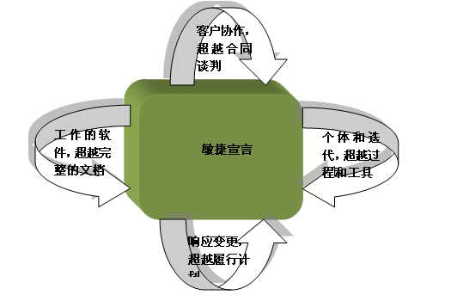
JMockit深入剖析

Slide 4
JMockit深入剖析
敏捷12原则:
1. 通过及早并持续地交付有价值的软件来满足客户是我们最优先关注的事情。
2. 欢迎需求变更，即便是在开发的后期。敏捷过程利用变更为用户创造竞争优势。
3. 频繁交付可工作的软件，时间周期从几周到几个月不等，优先采用小时间段。
4. 业务人员和开发人员平时在整个项目中必须一起工作。
5. 围绕被激励起来的个人构建项目。给他们提供需要的环境和支持，相信他们可以把工作做好。
6. 向开发团队以及其内部传递信息最有成效的方法是面对面交谈。
7. 可工作的软件是首要的进度度量指标。
8. 敏捷过程提倡可持续的开发。责任人、开发者和用户应该能够保持一个长期的、恒定的开发速度。
9. 持续关注技术优势和优秀设计以增强敏捷能力。
10. 简化是必须的。
11. 最好的架构、需求和设计出自于自组织团队。
12. 团队定期就如何变得更敏捷进行反思，然后相应地调整其行为。

Slide 5
JMockit深入剖析
面对敏捷开发,TDD适合我们吗? - 呼之欲出的持续测试框架
一款优秀的测试框架应具备哪些特性?
1.断言机制(Assertion & Hamcrest)
2.Mock & Stub机制(动态代理 & cglib字节码修改)
3.DB testing support
4.Web application support(Socket, Java Mail, JMS, JWS-RPC and so on)
5.主流开源框架特性支持
6.主流IDE Plug-in
7. …….

Slide 6
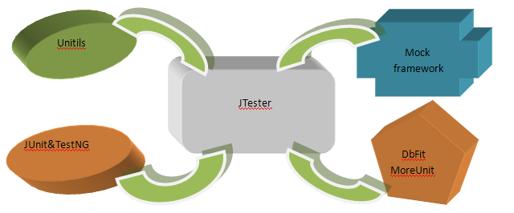
JMockit深入剖析

Slide 7
JMockit深入剖析
既生JUnit,何生TestNG?
开源的人无疑是幸福的,根据业务需求,我们如何进行扩展?JTester又是如何扩展的?
Thinking….
没错,优雅的架构需要设计模式 , Observer , Composite , Decorator…
有据可依的…

Slide 8
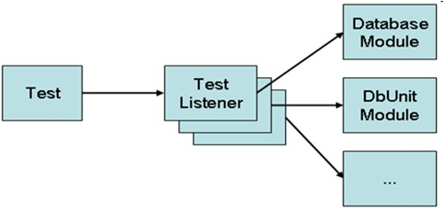
JMockit深入剖析

Slide 9
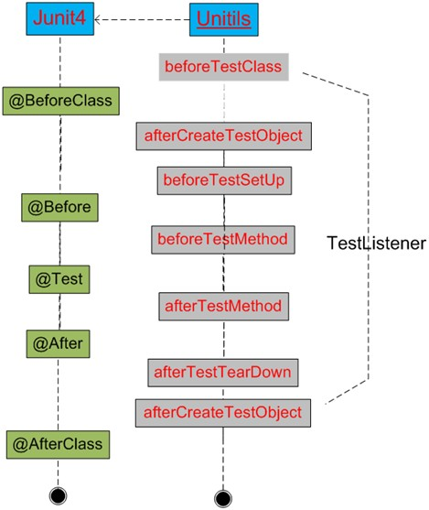
JMockit深入剖析

Slide 10
JMockit深入剖析
Behavior-based tests & State-based tests(Martin Fowler都容易搞混的概念)
Mock & Stub(在mock社区看来，最本质的区别就在于mock所具有的expectation setting机制，利用此机制可以测试mock上有哪些方法被调用)
备注: 一种理解
Behavior-based tests对于所有次要对象编写mocks。State-based tests仅仅对那些不实际使用real object的object编写stubs （一般的stub都被发现于系统边界，或者围绕着系统中复杂的对象群）。

Slide 11
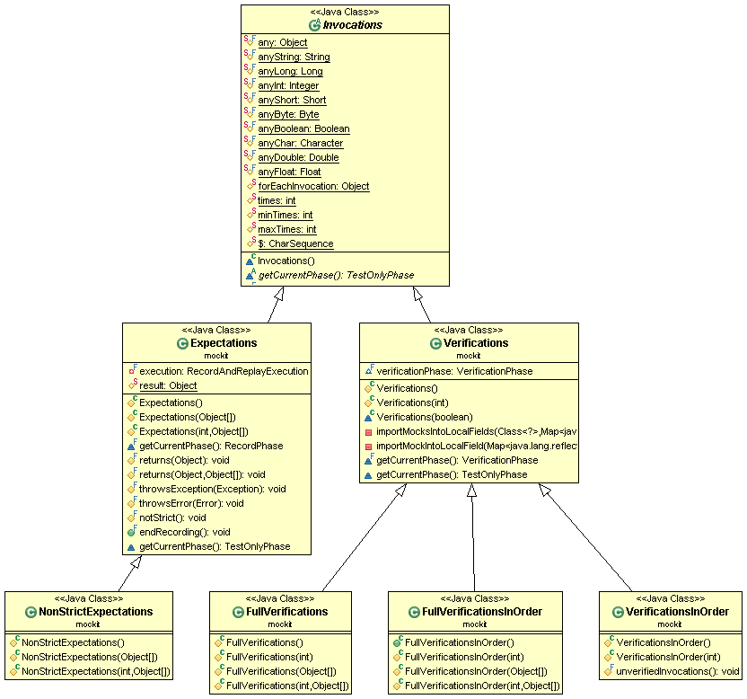
JMockit深入剖析

Slide 12
JMockit深入剖析
The record-replay-verify model
@Test
public void methodTest()
{
// 1. Preparation: whatever is required before the unit under test can be exercised.
...
// 2. The unit under test is exercised, normally by calling a non-private method
// or constructor.
...
// 3. Verification: whatever needs to be checked to make sure the exercised unit
// did its job.
...
}

Slide 13
JMockit深入剖析
This model of three phases is also known as the Arrange, Act, Assert syntax, or "AAA" for short. Different words, but the meaning is exactly the same.
一些比较重要的地方:
(1). Constraint-based matching of argument values (leniency match)
备注: 除了几种预定义的匹配约束外, Jmockit允许通过Hamcrest库的泛型方法进行自扩展
<T> T with(org.hamcrest.Matcher<T>)
<T> T with(T, org.hamcrest.Matcher<T>)

Slide 14
JMockit深入剖析
Using the null value to match any object reference
  dependency.voidMethod(withEqual("str"), null);
  (2). Strict and non-strict expectations
  a. Must occur(Invocation) in replay phase
  b. Must in the same order as they were recorded
  c. Any unexpected invocations that were not recorded will automatically cause the test to fail.
  Expanding: Strict and non-strict mocks

Slide 15
JMockit深入剖析
@Mocked (2-2-3)
a. instance field and parameter(scope)
b. except for primitive and array types(exception target)
c. concrete or enum class, interface or annotation and abstract class(mock rules)
Broadening: methods,inverse,capture,constructorArgsMethod,realClassName

Slide 16
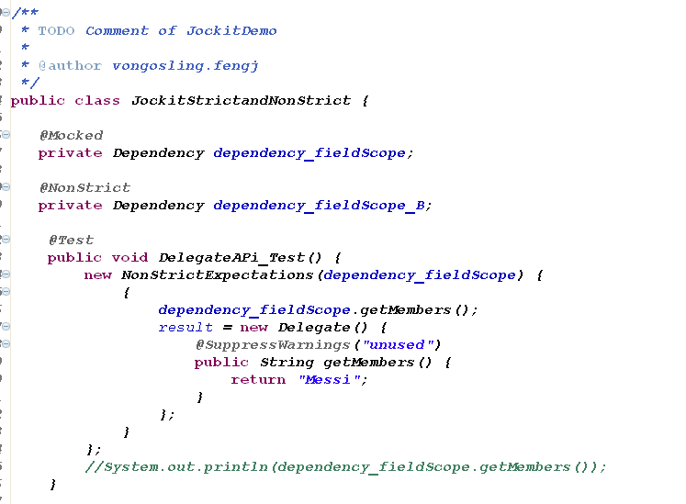
JMockit深入剖析

Slide 17
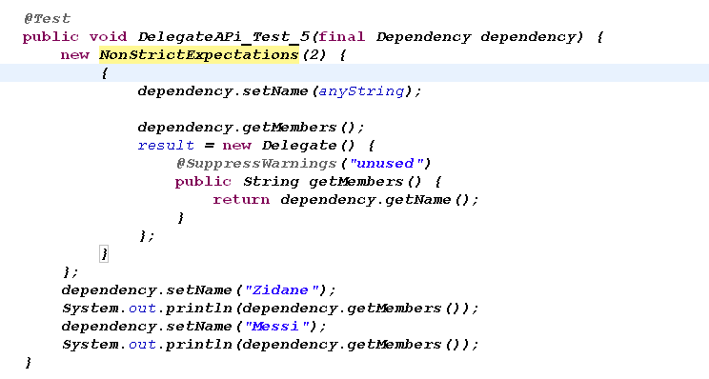
JMockit深入剖析
(3) Iterated expectations

Slide 18
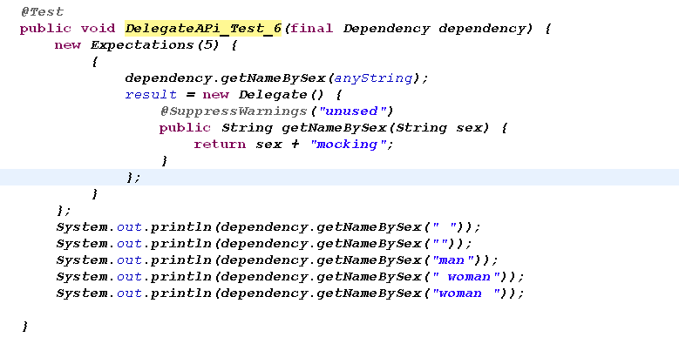
JMockit深入剖析
(4) Delegates: specifying custom results and capturing arguments

Slide 19
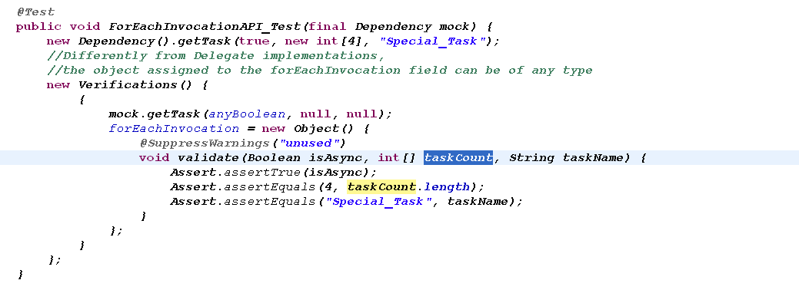
JMockit深入剖析
(4) Validating invocation arguments (Delegate implementations limited to expectation blocks)

Slide 20
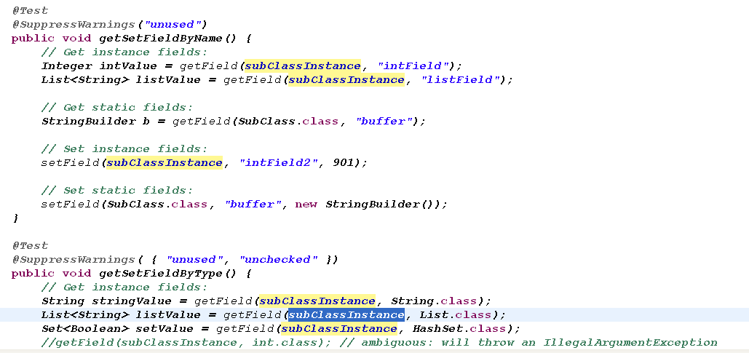
JMockit深入剖析
(5) Accessing private fields, methods and constructors

Slide 21
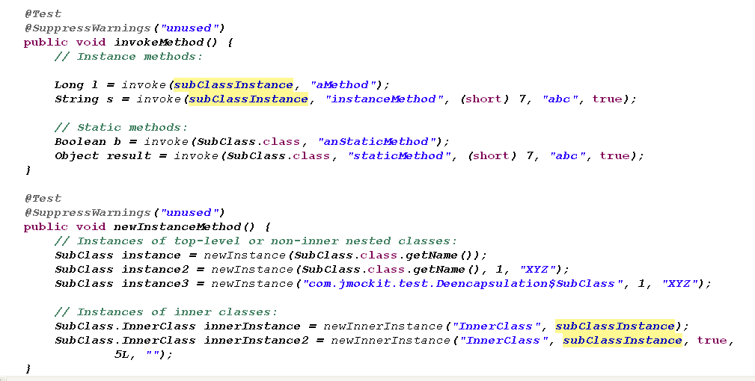
JMockit深入剖析

Slide 22
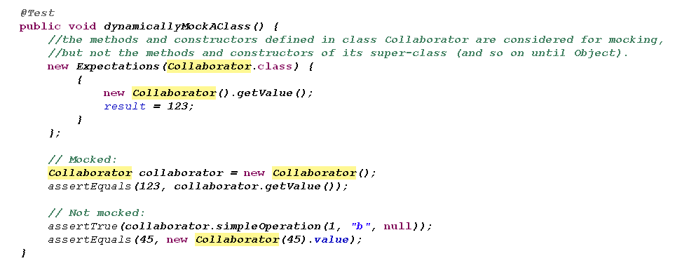
JMockit深入剖析
(5) Dynamic partial mocking

Slide 23
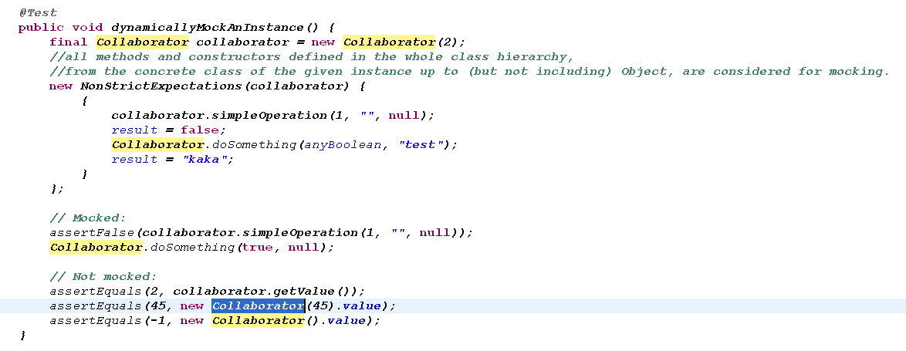
JMockit深入剖析

Slide 24
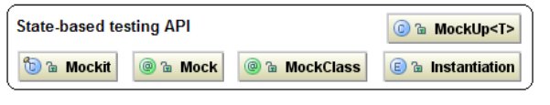
JMockit深入剖析
In the JMockit toolkit, the Annotations API provides support for the creation of state-based tests. The focus when doing this kind of testing is not on the interactions between objects, but on their state after the code under test is exercised, and on the data items exchanged between objects.

Slide 25
JMockit深入剖析
(1) Setting up mocks for a real class chosen at setup time
(2) Using the @MockClass annotation
(3) In-line mock classes

Slide 26
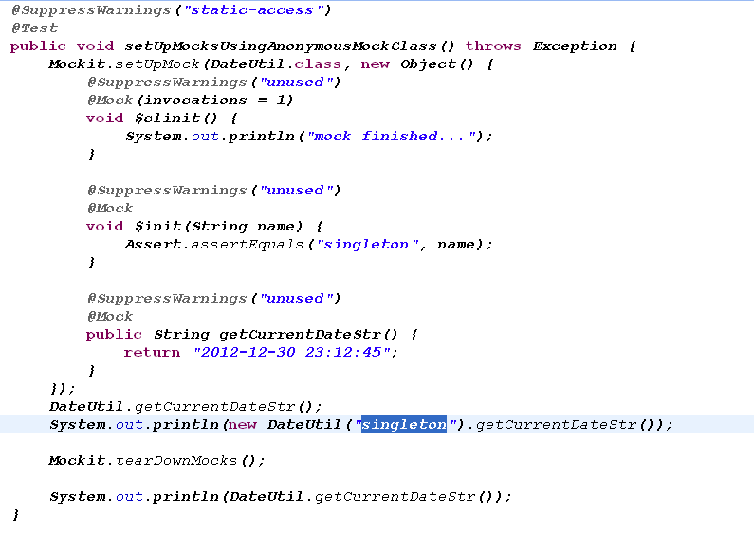
JMockit深入剖析

Slide 27
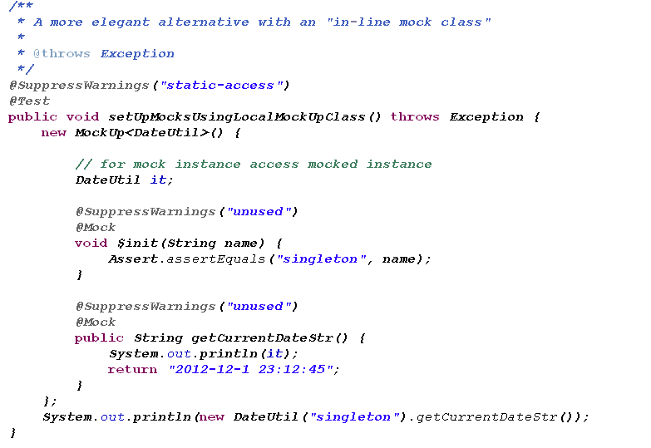
JMockit深入剖析

Slide 28
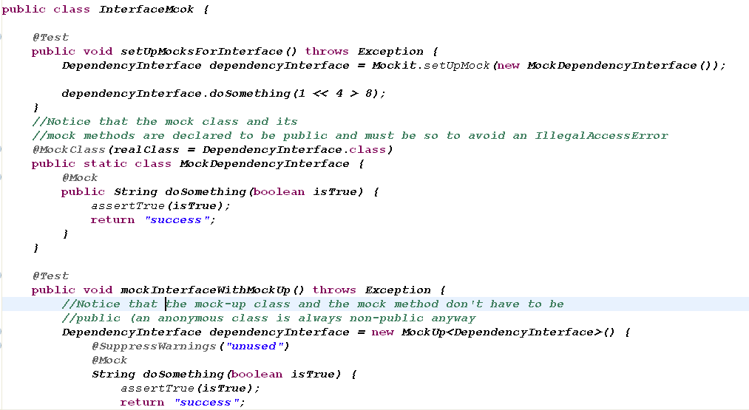
JMockit深入剖析
(4) Mocking interfaces

Slide 29
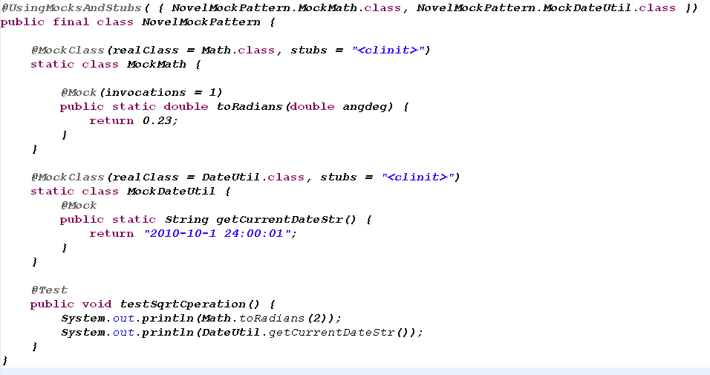
JMockit深入剖析
(5) Using mocks and stubs over entire test classes and suites

Slide 30
JMockit深入剖析
如何设置合理的Mock class?(mock object lifetime)
1. Instantiation.PerMockInvocation
Mock instance在方法被调用时创建,并且调用结束后丢弃.
注意:当传递一个class literal,并且不指定instantiation 属性时,该模式自动被开启
2. Instantiation.PerMockSetup
setUpMock/setUpMocks方法执行时创建,只要未执行Mockit.tearDownMocks,该single mock instance一直有效.
注意:该模式类似于给setUpMock方法传递一个mock instance,该single mock instance将被用于所有实例方法的调用(只要mock class保持有效)

Slide 31
JMockit深入剖析
3. Instantiation.PerMockedInstance
与Instantiation.PerMockSetup不同之处在于其按需创建的特性(及不受范围的限定)和创建时间点.
发散点,拓宽研究:
Measuring code coverage
Running test suites incrementally
……

Slide 32
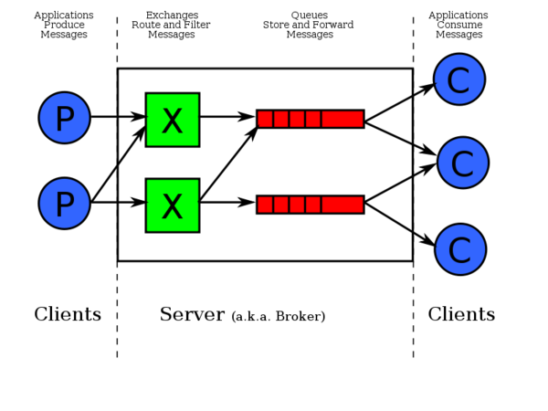
AMQP

Slide 33
参考文献
http://code.google.com/p/jmockit/
http://www.ibm.com/developerworks/cn/opensource/os-junit/
http://en.wikipedia.org/wiki/Code_coverage
http://www.martinfowler.com/articles/mocksArentStubs.html

Slide 34
Thanks

